Slide 1

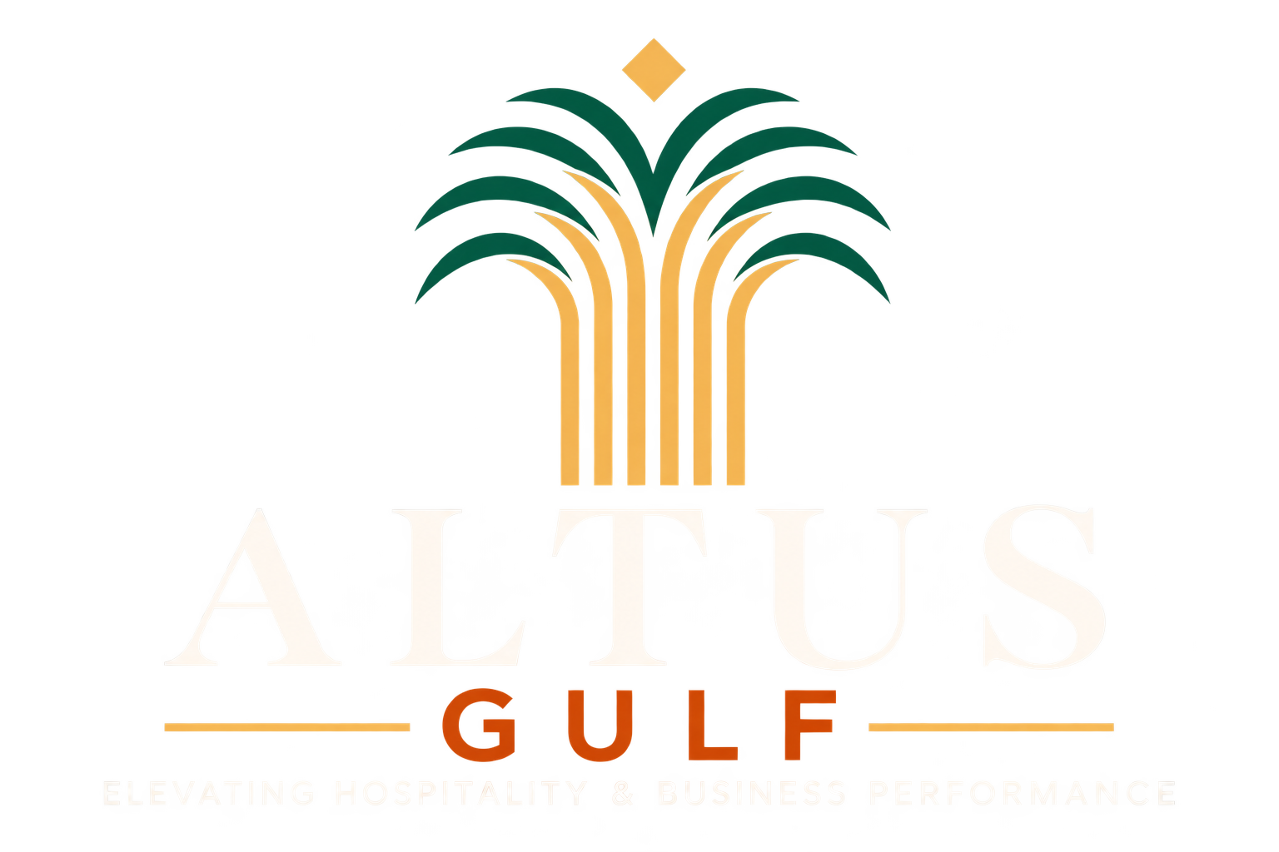
STRATEGIC ADVISORY & BUSINESS CONSULTANCY
CORPORATE PROFILE
2026 EDITION
“The future belongs to those who prepare for it.
We do not adapt to the market. We help shape it.”
A boutique strategy house operating at the intersection of hospitality operations and applied business intelligence, built for the Kingdom's next decade.
60+
2
12
1
Years Combined
Leadership
Integrated
Divisions
Sectors
Served
Proprietary
Platform
RIYADH • KINGDOM OF SAUDI ARABIA • GCC & MENA
Elevating Hospitality & Business Performance

Slide 2
GUIDE TO THIS DOCUMENT
Contents
A guide to this document's twenty-five sections, from firm overview and service portfolio through to our proprietary digital platform, market data, and executive leadership.
01
A Message from the Founders
03
14
Illustrative Case Studies — I
16
02
Company Overview
04
15
Illustrative Case Studies — II
17
03
Why Altus Gulf
05
16
Islam Mahrous, Co-Founder
18
04
Hospitality Solutions
06
17
HussamSmadi, Co-Founder
19
05
Business Growth Solutions
07
18
Strategic Partnerships
20
06
Altus Gulf Hospitality Knowledge & Performance
08
19
Our Values
21
07
How the Altus Gulf Model Differs
09
20
ESG & Sustainability
22
08
Industries We Serve
10
21
Digital & AI
23
09
The Altus Ascent™ Framework
11
22
Why Clients Choose Altus Gulf
24
10
Strategic Frameworks
12
23
Closing & Contact
25
11
Institutional Capabilities
13
12
Engineered for Saudi Vision 2030
14
13
Market Opportunity
15
ALTUS GULF
CORPORATE PROFILE • 02

Slide 3
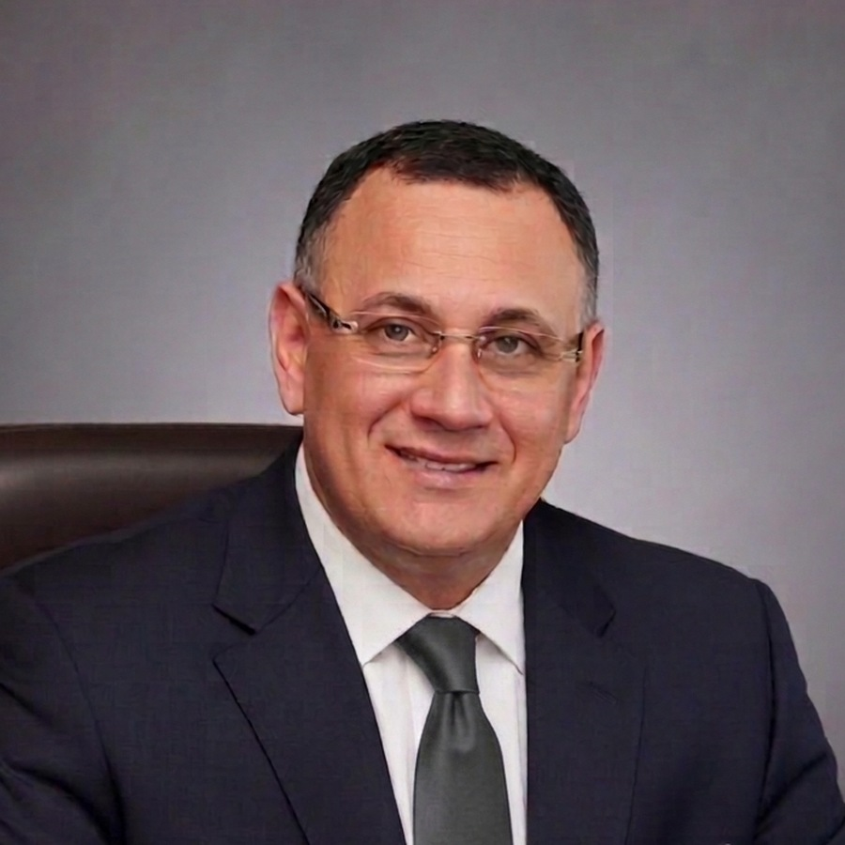
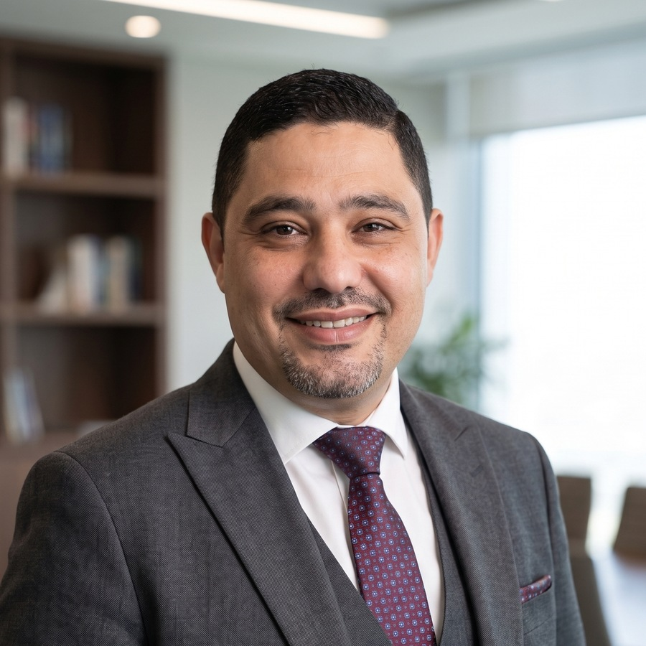

01 • LEADERSHIP PERSPECTIVE
A Message from the Founders
Global commerce is evolving at an unprecedented pace, and legacy operating frameworks are no longer sufficient on their own to secure market leadership. As the future architecture of business takes shape, one truth stands out: genuine excellence comes from the close integration of human capital and technological innovation.
We founded Altus Gulf to close a structural gap in the market. Asset owners and senior leadership teams are too often asked to choose between conventional hospitality operators' consultants and standalone digital agencies. Altus Gulf occupies the precise, multidisciplinary intersection of the two.
Islam Mahrous
Co-Founder — Brand, Commercial Strategy & AI-Driven Digital Transformation
We favour evidence over instinct. We work from advanced empirical analytics, help engineer measurable growth, and support the conversion of physical assets into high-performing, digital-first institutions. That conviction now extends into product: our proprietary Altus Gulf Hospitality Knowledge & Performance platform institutionalises the very expertise we advise with.
Our approach is straightforward. We stand beside you, shoulder to shoulder, from the first blueprint through sustained execution, and beyond it, until your organisation reaches greater operational consistency, stability, and confidence. The engagement may end; the alliance does not.
HussamSmadi
Co-Founder — Hospitality Operations & Asset Management
"
Commercial considerations are a reality of business, but for us they come second. What comes first is helping you build a genuine success story.
60+
4
3
Islam Mahrous • HussamSmadi — Co-Founders, Altus Gulf
Combined years
of leadership
Global brand
systems
Regions: GCC,
Egypt, N. Africa
ALTUS GULF
CORPORATE PROFILE • 03

Slide 4


02 • WHO WE ARE
Company Overview
Altus Gulf is a specialised strategy and advisory consultancy built on rigorous international standards. We work where hospitality operations meet applied business intelligence, serving asset owners, investors, and ambitious enterprises across Saudi Arabia, the GCC, and global markets.
OUR VISION
OUR MISSION
To be a leading strategic catalyst for hospitality excellence and enterprise transformation: championing bold founders, scaling enterprises, and visionary owners as they define the future of business performance.
To empower asset owners, investors, and business leaders with executable strategy, applied technology infrastructure, and human-capital frameworks: supporting sustainable revenue growth, operational independence, and consistently strong experiences across every physical and digital touchpoint.
OUR PURPOSE
The beating heart of our mission is to champion start-ups, scaling enterprises, and every investor or entrepreneur with a bold ambition — acting as a trusted strategic partner that helps turn ambition into practical, high-value results across the GCC and beyond.
CORE PHILOSOPHY
Owner-Side Discipline
Evidence over Intuition
Partnership beyond the Mandate
We sit on the owner's side of the table: independent, closely engaged, and measured against your returns, not our billable hours.
Every recommendation is grounded in empirical analytics, financial modelling, and field-tested operating discipline.
Engagements evolve into enduring alliances. We remain invested in our clients' trajectory long after delivery.
Two synergistic practices, one integrated house: Hospitality Solutions and Business Growth Solutions, cross-pollinating operational mastery with digital sophistication.
ALTUS GULF
CORPORATE PROFILE • 04

Slide 5




03 • THE ALTUS GULF EDGE
Why Altus Gulf
The consulting landscape too often operates in silos: traditional operations on one side, digital transformation on the other. Altus Gulf was built to close that structural gap with a single, integrated mandate.
Owner-Side Advisory
Operator-Grade Depth
Independent, client-side oversight across the full asset lifecycle: helping protect budgets, govern HMAs, and manage operator and contractor risk on the owner's behalf.
Leadership formed inside Marriott, IHG, Starwood, and Accor systems. 60+ combined years of P&L experience, not theoretical frameworks.
A Dual-Discipline Model
Regional Fluency, Global Standards
Hospitality operations fused with AI-enabled commercial intelligence, engineering growth across both domains at the same time.
Deep-rooted Saudi and GCC market knowledge, bilingual delivery, and Tier-1 international benchmarks applied without dilution.
Evidence over Intuition
An Enduring Partnership
Empirical analytics, financial modelling, and Six Sigma discipline replace opinion. Every recommendation is measurable and auditable.
Hands-on guidance from first blueprint to sustained execution: a relationship designed to outlast the engagement itself.
PROPRIETARY PLATFORM • NEW
Altus Gulf Hospitality Knowledge & Performance
The differentiator few conventional consultancies carry: a white-label digital platform that converts our operating standards into structured learning, knowledge management, and measurable performance for every client property. See pages 08 and 09.
UNIQUE VALUE PROPOSITION
Hospitality operational excellence, integrated with AI-driven revenue intelligence: supporting measurable impact through strategic clarity, operational rigour, and continuous digital innovation.
ALTUS GULF
CORPORATE PROFILE • 05

Slide 6




04 • SERVICE PORTFOLIO • DIVISION I
Hospitality Solutions
Dedicated to the physical asset, the guest experience, and the operating engine of hospitality enterprises: structural, hands-on intervention that supports stronger returns.
Hotel Development & Owner Representation
Independent client-side oversight across the project lifecycle. We act as the link between investors and contractors: helping protect budgets, reduce design deficiencies, govern HMAs, and manage contractor claims through handover.
Operations Optimisation & Pre-Opening Support
Deep diagnostic assessments and restructuring of day-to-day operations. Structured project-management frameworks support smooth commercial launches, help manage delays, and support revenue generation from day one.
Feasibility Studies & Investment Validation
Rigorous financial modelling, macro supply-and-demand analysis, and empirical ROI forecasting: giving institutional investors greater confidence that capital allocated to new hospitality assets is well supported by evidence.
Guest Experience Enhancement & Quality Audits
Systematic elevation of physical and digital touchpoints to global standards: rigorous brand-compliance audits, safety-procedure remediation, and mystery-guest programmes.
Commercial Performance Improvement
Holistic alignment of commercial sales, digital marketing, and internal operations. Disciplined cost-containment frameworks and distribution-channel analytics support stronger GOPPAR across the asset.
Engineering excellence. Supporting growth, from blueprint to full operational maturity.
ALTUS GULF
CORPORATE PROFILE • 06

Slide 7





05 • SERVICE PORTFOLIO • DIVISION II
Business Growth Solutions
The client-focused rigour of luxury hospitality, applied to the wider corporate landscape, for enterprises scaling regionally and globally.
Strategic Planning & Organisational Restructuring
Three-to-five-year strategic roadmaps and redefined corporate hierarchies: reducing administrative drag, increasing agility, and embedding change-management protocols aligned with labour regulation.
Revenue Optimisation & Applied AI
Dynamic pricing matrices, predictive yield management, and total revenue-capture systems, alongside enterprise AI-readiness assessments and phased technology deployment roadmaps.
Digital Transformation
End-to-end modernisation of internal technology stacks, CRM architecture, cloud-migration strategy, and integrated software blueprints: designed to lower long-run IT overheads and strengthen data security.
Leadership & Capability Development
Bespoke one-to-one executive coaching, leadership-competency frameworks, and corporate succession planning: building resilient executive layers capable of navigating complex transformation.
Investment Appraisal & M&A Due Diligence
Rigorous commercial due diligence for asset acquisitions, pre-acquisition valuation reporting, operational-synergy modelling, and post-merger integration plans that support capital discipline throughout the transaction.
Where hospitality meets intelligence: data-driven strategy, human-centred execution.
ALTUS GULF
CORPORATE PROFILE • 07

Slide 8


06 • PROPRIETARY DIGITAL PLATFORM
Altus Gulf Hospitality
Knowledge & Performance
A platform that converts three decades of hotel expertise and operating standards into a structured digital system for learning, knowledge management, and performance measurement. Built for independent hotels, serviced apartments, and SME establishments across Saudi Arabia and the wider region that need practical, standards-based training without the cost and complexity of global-chain systems.
THE PRODUCT VISION
"The right knowledge, to the right person, at the right time, with clear evidence of learning and improvement."
UNIFIED PLATFORM ARCHITECTURE • FIVE INTEGRATED LAYERS
1
Product & Experience
Clear scope and a consistent experience across information architecture and UX.
2
Knowledge & Learning
Knowledge architecture, master curriculum, learning engine, assessment and certification.
3
Intelligence & Performance
Knowledge engine, smart search, governed AI assistant, and live performance indicators.
4
Technical Operations
Database, identity and permissions, per-property customisation, admin and reporting.
5
Governance & Growth
Security and privacy, version control, product roadmap, web and mobile channels.
MASTER CURRICULUM • TEN PROFESSIONAL DOMAINS
Hotel Fundamentals
Front Office
Housekeeping
Food & Beverage
Kitchen
Sales & Marketing
Revenue & Reservations
Guest Experience
Quality & Audit
Security & Safety
Bilingual by design
White-label per property
Governed AI assistant
Evidence of progress
Arabic and English, one experience
Each establishment's own brand
Answers only from approved content
Dashboards, reports, certification
One platform. One standard. Measurable performance at every property.
ALTUS GULF
CORPORATE PROFILE • 08

Slide 9


07 • PROPRIETARY DIGITAL PLATFORM • THE COMPETITIVE EDGE
How the Altus Gulf Model Differs
Consultancies typically hand over reports. Software vendors hand over tools. Altus Gulf Hospitality Knowledge & Performance brings the two together: our consulting know-how, institutionalised inside a living platform that keeps building value long after the mandate.
DIMENSION | TYPICAL CONSULTANCY | GENERIC LMS / TRAINING VENDOR | ALTUS GULF HK&P
Source of content | External frameworks, generic decks | Off-the-shelf libraries, no hotel standards | Three decades of operator-grade SOPs and field-tested standards
After the engagement | Knowledge leaves with the consultants | Content ages without ownership | Knowledge stays institutionalised, versioned, and continuously updated
Fit to the property | One-size recommendations | No customisation, no Arabic depth | White-label, bilingual, tailored per property, role, and standard
Proof of adoption | Limited once the report is delivered | Completion clicks, not competence | Assessment, certification, and competency dashboards per employee
Intelligence | Static documents | Keyword search at best | Governed AI assistant answering strictly from approved content
MEASURABLE VALUE FOR OWNERS AND OPERATORS
40%+
High
100s
GOP ↑
Faster onboarding readiness
Knowledge retained in-house
Of training hours saved
Guest satisfaction & profit
New hires productive from day one.
Stays with the institution, not departing staff.
Replaces costly, repetitive classroom cycles.
Faster resolution supports scores and profit.
ONE PLATFORM, THREE EXPERIENCES
The Learner
Property Management
The Altus Gulf Team
Role-based plan, short applied lessons, assessment, live progress, and a completion certificate.
Assign tracks, follow team completion, read competency reports, and apply the property's own brand.
Content management, quality control, versioning, client administration, and cross-property analytics.
ALTUS GULF
CORPORATE PROFILE • 09

Slide 10










08 • SECTOR COVERAGE
Industries We Serve
One operating philosophy, applied across the sectors driving the Kingdom's transformation, wherever service, asset performance, and guest experience decide the outcome.
Hotels
Luxury Resorts
Tourism & Destinations
Real Estate
Government & PSAs
Mixed-Use Developments
Entertainment
Healthcare Hospitality
Retail & F&B
Sports & Events
Investment & PE
Family Offices
Committed at every scale: from a boutique independent property taking its first steps, to national portfolios and global enterprises. The same exacting care, dedication, and strategic rigour.
ALTUS GULF
CORPORATE PROFILE • 10

Slide 11
09 • PROPRIETARY METHODOLOGY
The Altus Ascent™ Framework
A six-stage operating discipline that carries every mandate from first diagnostic to institutionalised, self-sustaining performance, with defined gates, deliverables, and owner sign-off at each stage.
1
DISCOVER
Immersive diagnostic of the asset, market, and organisation. Data rooms, field audits, stakeholder interviews, and competitive benchmarking establish the factual baseline.
2
ASSESS
Gap analysis against global standards and investor objectives. Financial modelling, risk mapping, and opportunity sizing convert findings into a quantified case for change.
3
DESIGN
The strategic blueprint: operating model, commercial architecture, organisational structure, and technology roadmap, each with owners, milestones, and measurable targets.
4
TRANSFORM
Hands-on, shoulder-to-shoulder execution. We embed alongside client teams to implement, coach, and course-correct, not observe from a distance.
5
OPTIMISE
Performance instrumentation, dashboarding, and iterative refinement. Pricing, cost, quality, and guest-experience levers tuned against live data.
6
SCALE
Institutionalisation and growth: playbooks, capability transfer, and governance handover so momentum can compound long after the engagement concludes.
Precision in planning. Discipline in execution.
ALTUS GULF
CORPORATE PROFILE • 11

Slide 12
10 • ORIGINAL CONSULTING MODELS
Strategic Frameworks
Two proprietary lenses through which Altus Gulf reads an asset: locating it on the performance map, then mapping the route toward compounding returns.
A. THE ALTUS PERFORMANCE MATRIX™
↑ OPERATIONAL RIGOUR
LEGACY OPERATOR
THE ALTUS GULF ZONE
Our mandate: move every client asset up and to the right, into the Altus Gulf Zone.
Sound operations,
analogue commercial engine
Operational mastery × digital intelligence:
compounding performance
UNDERMANAGED ASSET
DIGITAL VENEER
Capital deployed,
potential unrealised
Technology adopted,
operations underpowered
DIGITAL & COMMERCIAL INTELLIGENCE →
B. THE GOPPAR VALUE STACK™
TOP-LINE CAPTURE
Dynamic pricing • predictive yield • total revenue systems
DISTRIBUTION ECONOMICS
Channel-mix optimisation • OTA governance • direct-booking growth
COST CONTAINMENT
Disciplined cost frameworks • procurement discipline • productivity
ASSET PRODUCTIVITY
Space monetisation • capex governance • energy & lifecycle efficiency
GOPPAR
EXPANSION
One diagnostic. One value model. A shared language for every mandate.
ALTUS GULF
CORPORATE PROFILE • 12

Slide 13




11 • WHAT WE BRING TO THE TABLE
Institutional Capabilities
Eight integrated capability sets, deployed selectively per mandate, always in combination, never in isolation.
Operational
Commercial
SOP architecture, quality systems, pre-opening readiness, service-delivery engineering across rooms, F&B, and support functions.
Revenue strategy, sales-force effectiveness, distribution and channel economics, brand and marketing performance.
Financial
Investment
P&L restructuring, cost-containment frameworks, budgeting and forecasting discipline, capex governance and ROI tracking.
Feasibility validation, underwriting support, due diligence, valuation and synergy modelling for acquisitions and development.
Digital & AI
Organisational
AI-readiness assessment, dynamic pricing, predictive analytics, CRM and technology-stack modernisation, plus the Altus Gulf HK&P platform.
Structure redesign, role clarity, succession planning, leadership coaching, and capability-transfer programmes.
Governance
Transformation
HMA oversight, owner and operator alignment, performance-clause monitoring, reporting and board-level assurance.
Turnaround management, change protocols, post-merger integration, and enterprise-wide performance programmes.
Every capability is delivered by principals, never delegated to a junior bench.
ALTUS GULF
CORPORATE PROFILE • 13

Slide 14

12 • NATIONAL ALIGNMENT
Engineered for Saudi Vision 2030
Vision 2030 is not a blueprint of the future; it is a live, national-scale transformation already underway. Altus Gulf has aligned its mission and service architecture to directly support the Kingdom's core pillars, so our partners do not merely take part in this historic growth: they help lead it.
PILLAR I
PILLAR II
Powering the Tourism & Hospitality Surge
Advancing Digital & AI Leadership
With the Kingdom targeting 150 million annual visits by 2030, we act as a strategic partner to developers and investors: owner representation, feasibility validation, and operational optimisation that support the delivery of new hotel assets on time, on budget, and engineered for GOP from day one.
Supporting a digitally enabled society and tech-forward economy: AI-based dynamic pricing, predictive revenue management, and advanced digital marketing. Our Altus Gulf Hospitality Knowledge & Performance platform replaces paper-based procedures with a governed digital system that supports transparency and a culture of continuous improvement.
PILLAR III
PILLAR IV
Empowering Saudi Human Capital
Enabling SMEs, Start-ups & Bold Entrepreneurs
In step with Saudization and youth-empowerment goals, our executive coaching, leadership-competency frameworks, and knowledge-transfer programmes help build a globally competitive class of Saudi executives, now delivered at scale through the platform's bilingual digital academy, learning paths, and certification.
Vision 2030 prioritises SME contribution to GDP. We bring Tier-1 consulting standards, typically reserved for larger groups, to Saudi start-ups and scale-ups, and we priced our platform deliberately for independent hotels and SME establishments, supporting resilience and growth from day one.
OUR ROLE IN THE KINGDOM'S GROWTH
We see Vision 2030 as a shared national opportunity. Working at the meeting point of hospitality operations and applied business intelligence, and investing in proprietary Saudi-focused digital products, we help equip our partners in the Kingdom to shape the future of their sectors.
ALTUS GULF
CORPORATE PROFILE • 14

Slide 15
13 • THE SAUDI GROWTH RUNWAY
Market Opportunity
The Kingdom is executing one of the most ambitious hospitality build-outs in the world. The numbers define both the scale of the opportunity and the premium on disciplined, owner-side execution.
122M
SAR 300B
362K
78%
domestic & international
visits in 2025 (+5% YoY)
total tourism spending
in 2025 (≈ USD 81B)
projected hotel keys
by 2030 (from ~167.5K)
of pipeline in luxury,
upscale & upper-upscale
VISITOR TRAJECTORY TOWARD THE 150M TARGET (MILLIONS OF VISITS)
HOTEL SUPPLY EXPANSION (THOUSANDS OF KEYS)
DEMAND CATALYSTS
35.7M Umrah pilgrims (2024): record religious demand
Expo 2030 Riyadh • FIFA World Cup 2034 • Asian Winter Games 2029
Giga-projects: NEOM, Red Sea, Diriyah, AlUla, Qiddiya
Sources: Saudi Ministry of Tourism preliminary data (Jan 2026); Knight Frank, Saudi Arabia Hospitality Market Review 2025; Ministry of Hajj & Umrah, 2024.
ALTUS GULF
CORPORATE PROFILE • 15

Slide 16
14 • PROOF OF CONCEPT • I
Illustrative Case Studies
Composite engagements, anonymised and clearly labelled as illustrative. Each reflects the type of mandate our principals have personally led inside global brands and independent portfolios; individual results vary by asset, market, and execution.
ILLUSTRATIVE CASE STUDY
FLAGSHIP RESORT • EGYPT • TURNAROUND
Flagship Resort Turnaround & Sustained Market Leadership
CLIENT
A 300+ key branded beachfront resort in a competitive leisure market, underperforming its comp set on rate and guest sentiment.
CHALLENGE
Stagnant RevPAR, slipping guest-satisfaction scores, and margin pressure despite strong location fundamentals.
APPROACH
Full commercial re-engineering: pricing architecture, channel mix, service-culture programme, and Six Sigma-led guest-journey redesign with disciplined cost governance.
OUTCOME
The property rose to No. 1 in its competitive set and held the position for six consecutive years, alongside structural GOP margin expansion.
+25%
+30%
#1
$340K
RevPAR growth
guest satisfaction
comp set, 6 yrs
annual savings, 1 project
ILLUSTRATIVE CASE STUDY
MULTI-PROPERTY • 19 HOTELS • OPERATIONAL EXCELLENCE
Portfolio-Wide Operational Excellence Mandate
CLIENT
A global operator's country portfolio of 19 hotels and 3,000+ rooms spanning city, resort, and airport assets.
CHALLENGE
Inconsistent service delivery, fragmented F&B performance, and uneven brand-standard compliance across the estate.
APPROACH
Centralised excellence programme: standards harmonisation, targeted property-level diagnostics, capability coaching for GMs and HODs, and monthly performance instrumentation.
OUTCOME
Portfolio-wide uplift in guest satisfaction and F&B revenue within 18 months, with a repeatable playbook institutionalised across the estate.
19
3,000+
+10%
+8%
hotels, 1 mandate
rooms in scope
guest satisfaction
F&B revenue, 18 mo
ALTUS GULF
CORPORATE PROFILE • 16

Slide 17
15 • PROOF OF CONCEPT • II
Illustrative Case Studies
Pre-opening delivery and owner representation: two mandates where disciplined, client-side governance most directly supports invested capital. Presented as illustrative examples; individual results vary by asset, market, and execution.
ILLUSTRATIVE CASE STUDY
PRE-OPENING • KSA • DUAL LAUNCH
Simultaneous Dual-Hotel Pre-Opening & Ramp-Up
CLIENT
A regional hospitality group commissioning two new-build properties in the Kingdom within a single opening season.
CHALLENGE
Parallel critical paths across licensing, recruitment, OS&E procurement, systems, and brand standards, with little room for launch slippage.
APPROACH
Integrated pre-opening command structure: unified countdown plan, staged recruitment and training waves, procurement governance, and revenue systems live before soft opening.
OUTCOME
Both properties opened on schedule, transitioned to full operation, and reached market-leading profitability within the region.
2
90–95%
#1
T-0
hotels, simultaneous
readiness at launch
GOP, region post-ramp
on-time opening
ILLUSTRATIVE CASE STUDY
OWNER REPRESENTATION • RIYADH • 4 BRANDED ASSETS
Owner's Representative for a Branded Riyadh Portfolio
CLIENT
An institutional owner developing four internationally branded hotels within a flagship Riyadh financial and technology district.
CHALLENGE
Supporting owner interests across HMA governance, technical services, procurement and OS&E review, and operator handover, across four concurrent projects.
APPROACH
A dedicated owner-representation office: HMA compliance monitoring, design and procurement challenge, milestone-based contractor management, and structured building-handover protocols.
OUTCOME
Owner interests supported across all four assets: budgets defended, claims mitigated, and handovers executed to operator acceptance without material value erosion.
4
HMA
OS&E
100%
branded assets
full agreement governance
procurement review
handovers accepted
ALTUS GULF
CORPORATE PROFILE • 17

Slide 18
16 • EXECUTIVE LEADERSHIP
Islam Mahrous
CO-FOUNDER: BRAND, COMMERCIAL STRATEGY & AI-DRIVEN DIGITAL TRANSFORMATION
Islam is the firm's growth innovator and its forward-looking technological edge: the bridge between traditional business models and the demands of the modern era. Across three decades of multi-brand leadership with Marriott, IHG, Starwood, and Accor, and independent asset management across Saudi Arabia, the GCC, Egypt, and North Africa, he has shown entrepreneurs and investors alike that digital modernisation and brand clarity can be direct, measurable drivers of enterprise value. He is the product architect of the Altus Gulf Hospitality Knowledge & Performance platform.
TRACK RECORD
30+ years of multi-brand hospitality leadership across the GCC, Egypt, and North Africa: Marriott, IHG, Starwood, and Accor systems.
Led a flagship branded resort to No. 1 in Marriott's Egypt competitive set for six consecutive years: +25% RevPAR and +30% guest satisfaction with sustained GOP margin expansion.
Mandated by Marriott International to lead operational excellence across 19 hotels in Egypt (3,000+ rooms), lifting guest satisfaction 10% and F&B revenue 8% within 18 months.
Directed five pre-opening projects across Saudi Arabia, Libya, Egypt, and West Africa: 1,700+ rooms delivered at 90–95% operational readiness.
Six Sigma Black Belt: four certified DMAIC projects, including a guest-journey redesign saving USD 340K annually.
Oversaw a USD 10M+ capital renovation portfolio, delivering 7–20% cost savings with minimal disruption to the guest experience.
RECOGNITION
Marriott GM Award for Customer Service Excellence: MEA, 2017 & 2022
Starwood Best Operational Innovation Manager, 2007
ALTUS GULF
CORPORATE PROFILE • 18

Slide 19
17 • EXECUTIVE LEADERSHIP
HussamSmadi
CO-FOUNDER: HOSPITALITY OPERATIONS & ASSET MANAGEMENT
Hussamis the firm's operational architect. With deep expertise in the operating complexities of international hospitality, his focus is converting physical assets into high-performing, operationally strong institutions. Across 30+ years of executive leadership in hotel operations and asset management throughout Saudi Arabia and Jordan, spanning global brands and independent groups, he helps bring high-level strategy to life carefully on the ground, with close adherence to quality standards.
TRACK RECORD
30+ years of executive leadership in hotel operations and asset management across Saudi Arabia and Jordan: global brands and independent groups.
As General Manager, led a property from pre-opening to full operation and to the title of Best Economy Hotel in Saudi Arabia.
Delivered the highest GOP in the Jazan region while leading Swiss Blue Hotels properties, through commercial discipline and strict cost governance.
Successfully directed two simultaneous hotel openings in 2018, carrying both to full operation and revenue generation.
Owner's Representative for four internationally branded Riyadh assets: Crowne Plaza Digital City, InterContinental, Hotel Indigo, and Wyndham Grand at KAFD.
Directly governed Hotel Management Agreements (HMA), procurement and OS&E reviews, and operator building-handover processes.
RECOGNITION
Best Economy Hotel in Saudi Arabia, as General Manager
U.S. Embassy Riyadh recognition: Best Security Measures
ALTUS GULF
CORPORATE PROFILE • 19

Slide 20
18 • ECOSYSTEM & ALLIANCES
Strategic Partnerships
Altus Gulf operates as the hub of a deliberately curated ecosystem: aligning operators, capital, technology, and government so that every mandate draws on best-in-class execution partners.
Hotel Operators & Global Brands
Investors, Funds & Family Offices
Working relationships across international operating systems: supporting informed HMA negotiation, brand selection, and operator performance governance on the owner's behalf.
Advisory alignment with institutional investors, developers, and family offices: feasibility validation, underwriting support, and asset-performance stewardship across the hold period.
Technology & Data Partners
Government & Development Authorities
A vetted bench of PMS, revenue-management, BI, and AI solution providers: selected per mandate on merit, never on commission, preserving full advisory independence.
Constructive engagement with ministries, destination authorities, and giga-project entities: aligning private asset strategy with national tourism and Vision 2030 priorities.
THE INDEPENDENCE PRINCIPLE
We hold no equity in operators, take no vendor commissions, and carry no brand allegiance. Our partnerships exist to serve one interest: the client's. That independence sits behind every recommendation we make.
ALTUS GULF
CORPORATE PROFILE • 20

Slide 21



19 • WHAT WE STAND FOR
Our Values
Seven commitments that guide how we advise, how we execute, and how we behave when no one is watching.
Integrity
We act as a genuine partner on the client's side: realistic diagnostics, transparent reporting, and advice that serves your interest even when it costs us the engagement.
Excellence
Consistently high standards: a refusal of mediocrity through close attention to execution detail and strong global benchmarks.
Innovation
An agile pursuit of digital progress: actively seeking, testing, and integrating new capability as a competitive advantage.
Hospitality
Service is our native language. The guest's experience, and the owner's return on it, sit at the centre of every decision.
Performance
Data-driven precision: intuition deliberately replaced by empirical analytics, AI, and financial modelling. Impact that is measured, not asserted.
Trust
Earned through candour, confidentiality, and consistency: the currency of every boardroom relationship we hold.
Collaboration
Human-centred empowerment: we build alongside client teams and local talent, transferring capability rather than creating dependency.
ALTUS GULF
CORPORATE PROFILE • 21

Slide 22


20 • RESPONSIBLE PERFORMANCE
ESG & Sustainability
Sustainable performance is not a compliance exercise; it is an asset-value strategy. We help embed environmental, social, and governance discipline into the operating model itself.
Governance
Responsible Tourism
Transparent owner reporting, HMA and procurement integrity, anti-leakage controls, and board-grade assurance frameworks: the governance architecture that supports capital discipline and reputation alike.
Destination stewardship aligned with Vision 2030's regenerative tourism agenda: visitor-impact management, heritage protection, and guest experiences designed to give back more than they take.
Community & People
Operational Sustainability
Saudization-first talent strategies, local supplier development, fair and dignified workplaces, and structured knowledge transfer that aims to leave communities stronger than we found them.
Energy, water, and waste efficiency engineered into SOPs and capex plans: utilities intelligence and lifecycle costing that can reduce footprint while supporting GOP.
Assets that respect their destination tend to outperform those that merely occupy it.
ALTUS GULF
CORPORATE PROFILE • 22

Slide 23




21 • THE INTELLIGENCE LAYER
Digital & AI
Every Altus Gulf mandate ships with an intelligence layer: the instrumentation that turns operations into evidence, and evidence into advantage.
Business Intelligence
Executive Dashboards
A single source of truth across PMS, POS, channel, and financial data: unified, cleansed, and decision-ready.
Owner- and board-grade dashboards: RevPAR, GOPPAR, pickup, sentiment, and payroll productivity in one live view.
Applied AI
Advanced Analytics
Dynamic pricing matrices, predictive yield management, demand forecasting, and AI-readiness roadmaps deployed in phases.
Channel economics, guest-sentiment mining, cost-driver analysis, and scenario modelling for capital decisions.
Performance Monitoring
Digital Transformation
Continuous KPI instrumentation with alerting: variances surfaced in days, not at month-end post-mortems.
CRM architecture, cloud migration, and integrated technology blueprints that help cut long-run IT overheads.
Flagship product: Altus Gulf Hospitality Knowledge & Performance, the platform that institutionalises this intelligence layer inside every client property (pages 08 and 09).
From gut feel to ground truth: replacing intuition with empirical analytics, deliberately and everywhere.
ALTUS GULF
CORPORATE PROFILE • 23

Slide 24
22 • THE DECISION IN ONE PAGE
Why Clients Choose Altus Gulf
A candid comparison: how the Altus Gulf model differs from conventional consulting engagements, dimension by dimension.
DIMENSION | TRADITIONAL CONSULTING | ALTUS GULF
Perspective | Operator- or vendor-influenced viewpoints | Owner-side, independent, and client-focused
Delivery team | Partner sells, junior bench delivers | Principals deliver every mandate personally
Grounding | Frameworks and benchmarks from the outside | 60+ years of hands-on P&L leadership inside global brands
Scope logic | Operations or digital, sold separately | One integrated mandate across operations, commercial, and AI
Evidence | Opinion-led recommendations | Empirical analytics, Six Sigma discipline, measurable KPIs
Digital enablement | Advice ends at the report | Altus Gulf HK&P: a proprietary learning and performance platform that lives on inside the client
Engagement end | Report handover closes the file | Playbooks, capability transfer, and an enduring alliance
Regional depth | Fly-in, fly-out coverage | Riyadh-rooted, bilingual, Vision 2030-aligned by design
Fee philosophy | Billable hours as the objective | Client success first: commercial terms follow outcomes
The comparison is candid by intent: clients deserve to know exactly what they are buying.
The Altus Gulf difference in one sentence: we stay close to your business, measured by practical outcomes, and focused on the result, not simply the report.
ALTUS GULF
CORPORATE PROFILE • 24

Slide 25




LET'S SHAPE THE NEXT STAGE, TOGETHER
Wherever your establishment is today, the next stage starts with clarity.
Altus Gulf can help define the priorities, identify the opportunities,
and build a practical path forward.
YOUR NEXT STAGE STARTS HERE
Islam Mahrous
Hussam Smadi
CO-FOUNDER
CO-FOUNDER
Riyadh, Kingdom of Saudi Arabia • [Office address]
www.altusgulf.com [placeholder]
advisory@altusgulf.com [placeholder]
QR
linkedin.com/company/altus-gulf [placeholder]
ELEVATING HOSPITALITY & BUSINESS PERFORMANCE
© 2026 Altus Gulf. All rights reserved. • Strategic Advisory & Business Consultancy

